Slide 1
Stacks
Programming – Code Design and Data Structures

Slide 2

Contents
Stacks
Last In First Out
Properties of a Stack
Operations of a Stack

Slide 3
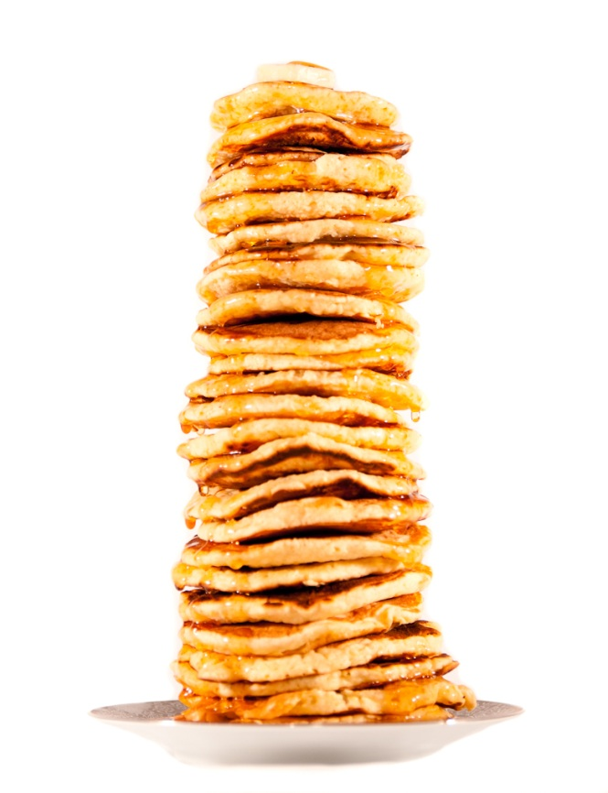
Pancakes
You can add pancakes to the top of the stack
But you can only safely eat the one on the top
Notes:
A visual representation.
Everyone uses the stack of plates analogy…. but I like pancakes.

Slide 4
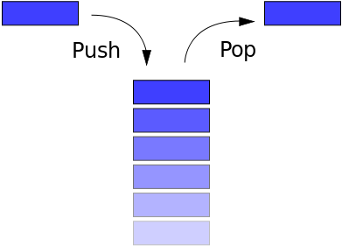
Stacks
Stacks are a container that work on the LIFO (Last In First Off) concept
This means that the last thing on the stack is the first thing to come back off
Elements can only be pushed onto the stack, and then popped off the stack
Is how your program runs and stores variables and function calls
Notes:
A stack will store data so that data is always added to or deleted from the top of the stack.
For example, C++ programs use a stack to manage automatic variables.
As new automatic variables are generated, they are added to the top of the stack.
When they expire, they are removed from the stack.
Properties of a stack in general:
A stack holds several items – that makes it a container
You can create an empty stack
You can add an item to the top of a stack (i.e., push an item)
You can remove an item from the top (i.e., you can pop an item)
You can check whether the stack is full
You can check whether the stack is empty

Slide 5
Properties of Stacks
Stacks are dynamically resizable arrays (of sorts)
As stacks are a LIFO container you cannot access any element within the container except for the last added element!
To get to an element that is underneath it you have to pop elements off
Notes:
If you are implementing your own stack, you are free to store the data however you want, however this needs to happen in the private section.
For example, you can use an ordinary array, a dynamically allocated array, or some more advanced data structure, such as a linked list.
(You may want to ask the students why you would use a specific data structure, or in what kind of situation a specific data structure – say, an array – would be more appropriate than another – say, a linked list.)
The public interface should hide the exact representation. It should be expressed in general terms, such as creating a stack, pushing an item, and so on.
The STL implementation of stack stores data in a dynamic array.
There are no iterators available to traverse a stack.

Slide 6
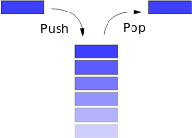
Operations of a Stack
The stack has a very limited set of operations when compared to other container types:
empty(): Returns true if stack is empty
size(): Returns the number of elements
push(value): Adds a value to the end/top
pop(): Removes element at the end/top of the stack
top(): Returns the value at the end of the stack

Slide 7
Stack Pseudocode
Let’s look at a simple stack class that will allow us to:
Push elements to the top of our stack
Pop elements off our stack
Check if our stack is empty
Check the size of our stack
Access the top element of our stack

Slide 8
Constructor
The constructor should:
Take in a stack size (capacity)
Allocate an array of size capacity (and initialize all values to 0 or nullptr)
Initialise array size (size) to capacity
Initialise top element (top) to -1
def Stack(capacity)
SET data to array of capacity elements SET size to capacity
SET top to -1

Slide 9
Push
Push adds an element to the top of the stack
Resize the stack when you run out of space
Much like a dynamic array
function Push(value)
INCREMENT top by 1
IF top equals size-1
resize data array
SET size to new size
ENDIF
SET data[ top ] to value

Slide 10
Pop
Pop removes the top element from the stack
We can do this by decrementing top by 1
function Pop()
IF top >= 0
SET data[ top ] to NULL
DECREMENT top by 1
END IF

Slide 11
Top
Returns the top element of our stack
If top < 0, return null or throw error
function Top()
IF top < 0
return null
ELSE
return data[ top ]
END IF

Slide 12
Empty and Size
Empty returns true if the stack is empty
Size returns the number of elements on the stack
function Empty()
IF top is equal to -1
return true
ELSE
return false
END IF
function Size()
RETURN top + 1

Slide 13
Destructor
As usual, our destructor should free any data that was created in our stack class
def ~Stack()
deallocate m_data

Slide 14
Summary
Stacks are a Last In First Out
Useful for solving certain types of problems
For example, the menu for a game could use a stack, where each sub-menu gets pushed on to the stack, and when we press back it gets popped off the stack so that we can access the previous menu

Slide 15
References
Prata, S, 2011, C++ Primer Plus, 6th Edition, Addison-Wesley
http://en.wikipedia.org/wiki/Stack_(abstract_data_type)
Notes:
The C++ Primer Plus reference actually has code for a Stack class

